Slide 1
Latest breakthrough in Indonesian Geothermal development”
Supreme Energy
28 January 2015

Slide 2
Presentation Agenda
PT Supreme Energy companies
Government guarantee breakthrough
Electricity Price breakthrough
Restricted forest entry breakthrough
Financing for exploration breakthrough
Civil infrastructure breakthrough
Exploration breakthrough
Summary

Slide 3
PT Supreme Energy has 3(three) Geothermal concessions
Concession at Muara Laboh at South Solok, West Sumatra – Supreme Energy Muara Laboh (SEML)
Concession at Rajabasa at South Lampung, Lampung – Supreme Energy Rajabasa (SERB)
Concession at Rantau Dedap, South Sumatra – Supreme Energy Rantau Dedap (SERD)

Slide 4
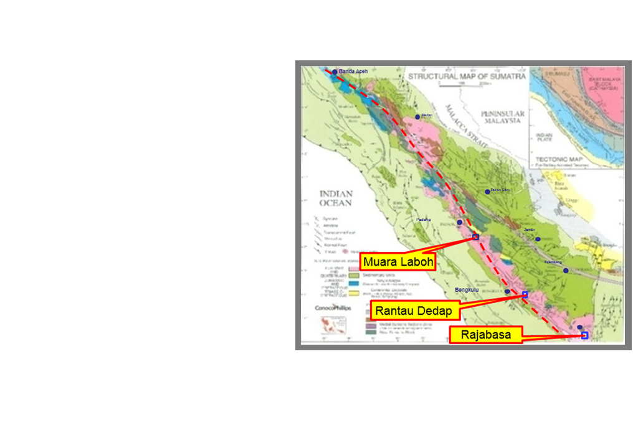
The concessions are along
the Great Sumatra Fault (GSF)

Slide 5
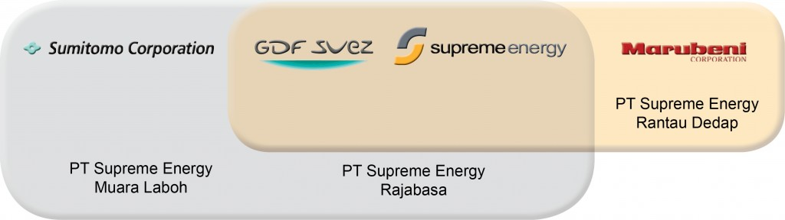
Shareholder structure of the 3(three) companies

Slide 6

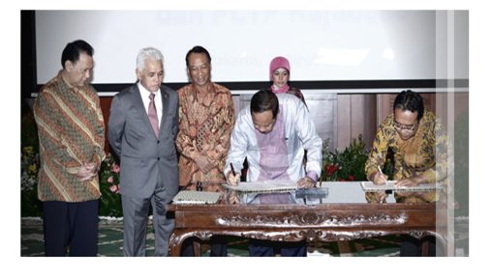
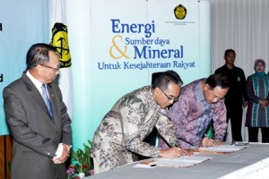
Power Purchase Agreement (PPA) signed
Power Purchase Agreements (PPA) with PT PLN (Persero) have been signed and also Business Viability Guarantee letters (BVGL) from Ministry of Finance have been issued for all 3(three) Projects
PPA for Muara Laboh and Rajabasa were signed on March 2, 2012 with electricity tariff of :
Muara Laboh : US$ 0.094 per kWh
Rajabasa : US$ 0.095 per kWh
PPA for Rantau Dedap was signed on November 12, 2012 with electricity tarif of US$ 0.0886 per kWh

Slide 7
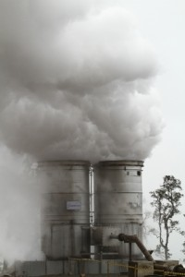
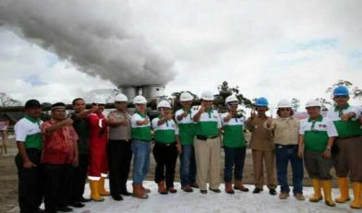
Current status of
Supreme Energy Muara Laboh (SEML)
Civil infrastructure completed
Exploration program completed
Geothermal reserves confirmed
EPC tender ongoing
Negotiation of tariff increase
Finance arrangement on-going

Slide 8
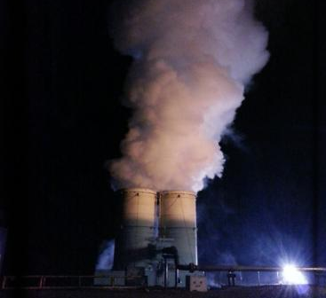
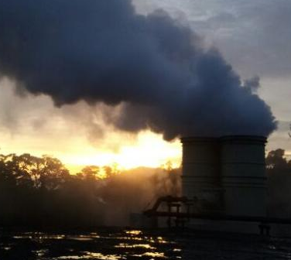
Current status of
Supreme Energy Rantau Dedap (SERD)
Civil infrastructure completed
Exploration program on-going drilling 5th well
Geothermal system found
ADB provided Clean Technology Fund (CTF) loan

Slide 9
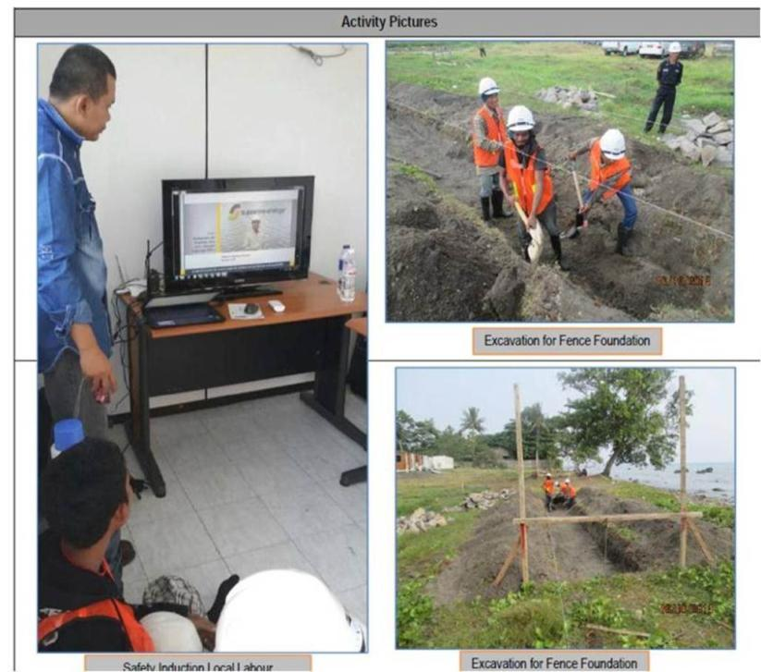
Current status of
Supreme Energy Rajabasa (SERB)
Civil infrastructure work is restarted
Currently work on security fence and Jetty to be started
Design of exploration program is under finalization

Slide 10
Presentation Agenda
PT Supreme Energy companies
Government guarantee breakthrough
Electricity Price breakthrough
Restricted forest entry breakthrough
Financing for exploration breakthrough
Civil infrastructure breakthrough
Exploration breakthrough
Summary

Slide 11
Government guarantee in the form of
Business Viability Guarantee letter (BVGL)
Basis for Guarantee letter
Article 7.2 of Presidential decree No 4 year 2010 for acceleration of Power plant development
Minister of Finance decree no: 139/PMK.011/2011 concerning Business Viability Guarantee letter (BVGL) to PT Perusahaan Listrik Negara (Persero)
Since BVGL is relatively new, Developer needs to explain in significant details all of the financial calculation to Ministry finance team on this matter. Basic discussion or difference in opinion is on the duration of the guarantee letter

Slide 12
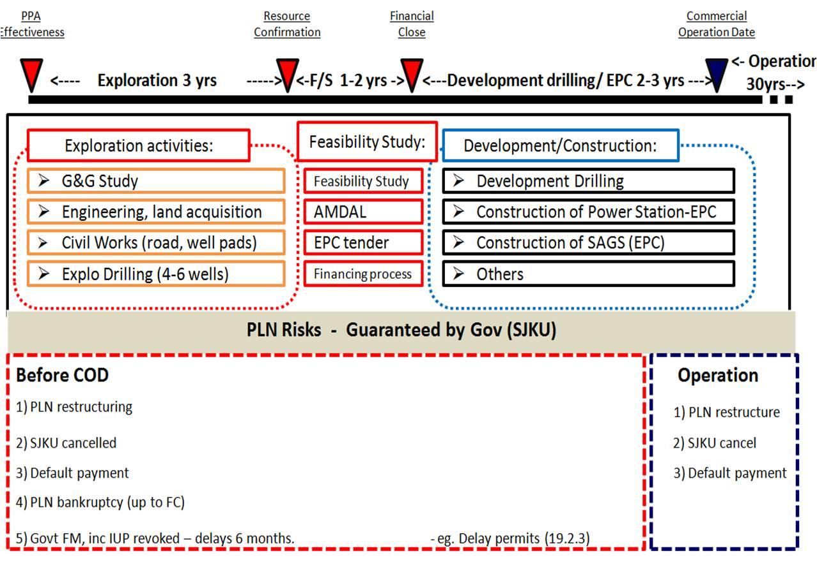
Basic Government Guarantee in the form of BVGL or in Indonesian languange called SJKU

Slide 13
Presentation Agenda
PT Supreme Energy companies
Government guarantee breakthrough
Electricity Price breakthrough
Restricted forest entry breakthrough
Financing for exploration breakthrough
Civil infrastructure breakthrough
Exploration breakthrough
Summary

Slide 14
Increased tariff ceiling Price
COD Years | Ceiling Price (cent USD/kWh)
 | Region I | Region II | Region III
2015 | 11.8 | 17.0 | 25.4
2016 | 12.2 | 17.6 | 25.8
2017 | 12.6 | 18.2 | 26.2
2018 | 13.0 | 18.8 | 26.6
2019 | 13.4 | 19.4 | 27.0
2020 | 13.8 | 20.0 | 27.4
2021 | 14.2 | 20.6 | 27.8
2022 | 14.6 | 21.3 | 28.3
2023 | 15.0 | 21.9 | 28.7
2024 | 15.5 | 22.6 | 29.2
2025 | 15.9 | 23.3 | 29.6

Slide 15
With new tariff – 7 (seven) Geothermal companies signed the PPA
1. PT OTP (Origin and Tata) - Sorik Merapi, North Sumatra
2. PT Medco Power Indonesia - Ijen, East Java
3. PT Bakrie Power (with Panax Geothermal) - Ngebel Willis, East Java
4. PT Rekayasa Industri and PT Jasa Sarana - Cisolok Sukarame, West Java
5. PT Wijaya Karya and PT Jasa Sarana - Tampomas, West Java
6. PT Sintesa Green Energy dan PT. Banten Global Synergi - Kaldera, Banten
7. PT Indonesia Power - Tangkuban perahu, West Java

Slide 16
Presentation Agenda
PT Supreme Energy companies
Government guarantee breakthrough
Electricity Price breakthrough
Restricted forest entry breakthrough
Financing for exploration breakthrough
Civil infrastructure breakthrough
Exploration breakthrough
Summary

Slide 17
Key Changes on New Geothermal Law
Licenses and Validity – can be extended unlimited
No More Mining Terms – easier to enter Restricted forest
Centralized Licensing – not at regions anymore
Pricing – Set by government and considers “economic cost”
Concession Size Rules Relaxed – no more 200.000 Ha capped
Production Bonus and Taxes – Royalties to Production bonus

Slide 18
Presentation Agenda
PT Supreme Energy companies
Government guarantee breakthrough
Electricity Price breakthrough
Restricted forest entry breakthrough
Financing for exploration breakthrough
Civil infrastructure breakthrough
Exploration breakthrough
Summary

Slide 19

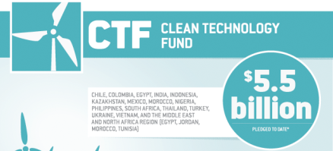


Clean Technology Fund Solution to be implemented for Rantau Dedap
US $ 50 million

Slide 20
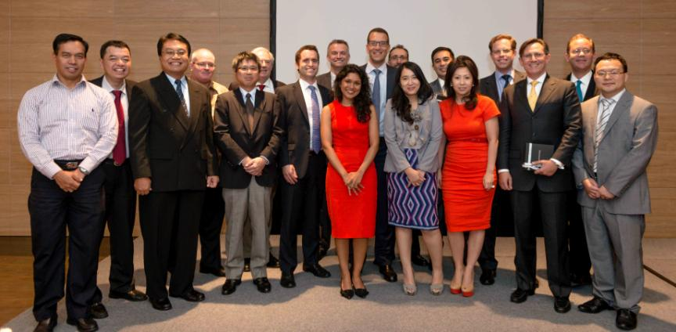
Asian Development Bank (ADB) takes exploration risk and provides Clean Technology Fund

Slide 21
Presentation Agenda
PT Supreme Energy companies
Government guarantee breakthrough
Electricity Price breakthrough
Restricted forest entry breakthrough
Financing for exploration breakthrough
Civil infrastructure breakthrough
Exploration breakthrough
Summary

Slide 22

Finding hot temperature system is related to well pad location
In many cases, higher elevation has better chance compared to low elevation
Typical High Grade
Fumaroles
H₂O,CO₂,H₂S
+2
Typical Marginal
Acid – SO₄, Pools
+1
Steaming Ground
Na–HCO₃– SO₄,
Springs
condensation
Cap Rock
NaCl Springs
vapor zone
SL
200 ºC
km
dilution
250 ºC
-1
300 ºC
Lateral outflow of NaCl brine
meteoric recharge
-2
upflow
-3
+
+ +
+ +
+ + +
+ + + + +
+ + + + +
+ + + + +
+ + + + + +
+ + + + + + +
-4
Magma Source
H₂O,CO₂,SO₂, HCl
Volcanic Arc Geothermal System

Slide 23
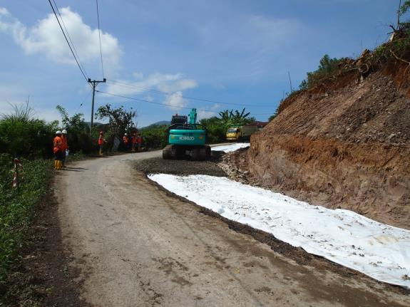
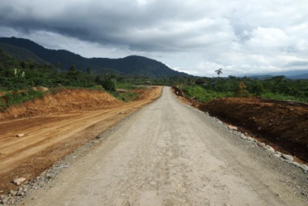
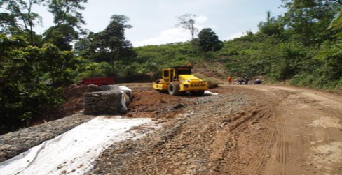
Construction of about 34 km of access roads

Slide 24
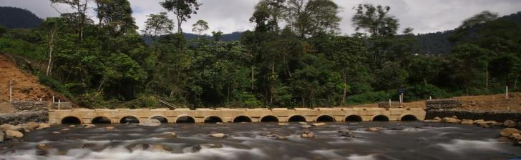
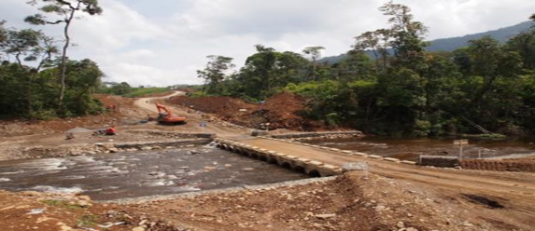
Road bridges has to be built across major rivers
Endikat River Ford

Slide 25
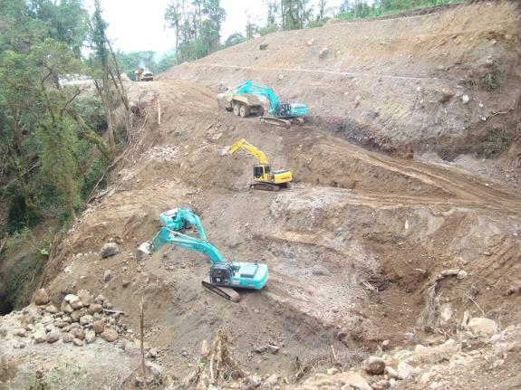
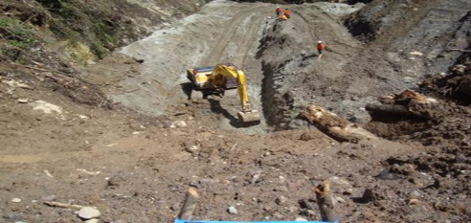
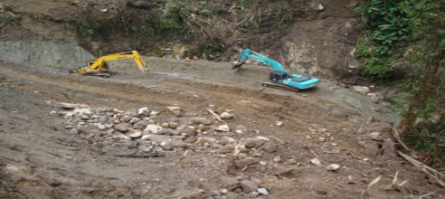
Extensive earth work were performed to build a bridge or Mechanically stabilized earth MSE Wall

Slide 26
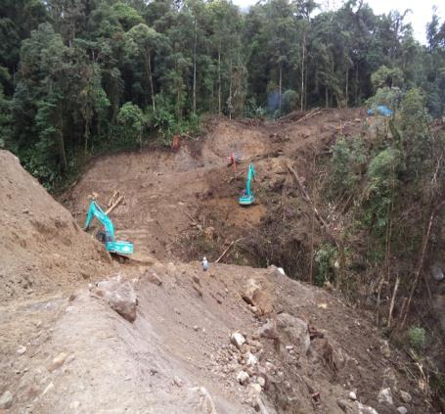
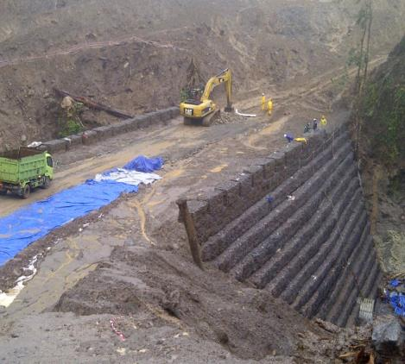
Stone bridges across ravines were built to reach the drilling well pad
`
~23m
river
Before
After

Slide 27
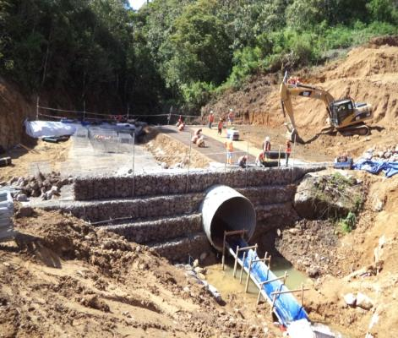
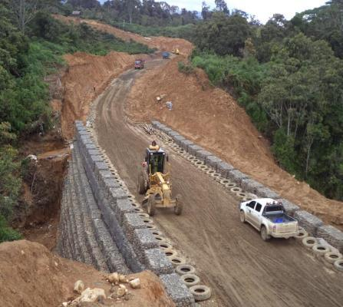
Stone bridge are built across major ravine -
Mechanically stabilized earth (MSE) Wall

Slide 28
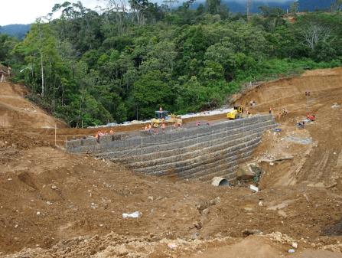
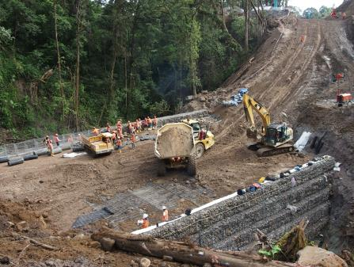
Crossing ravines and valleys in remote jungles needs special engineering and construction feat
Typical Mechanically Stabilized Earth (MSE) wall to cross deep ravines

Slide 29
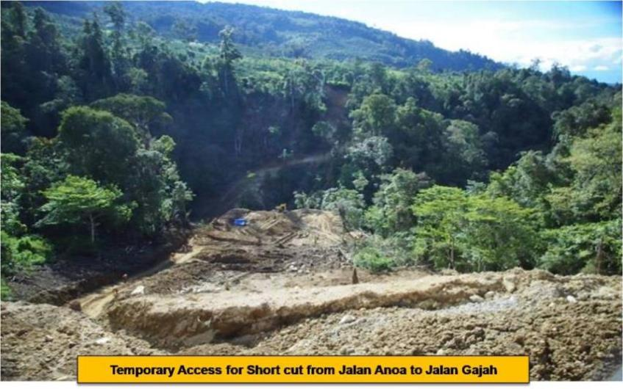
Making access roads to reach high elevation pads is a civil engineering challenge

Slide 30
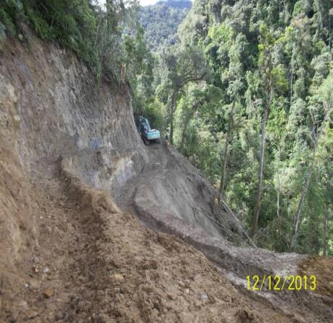
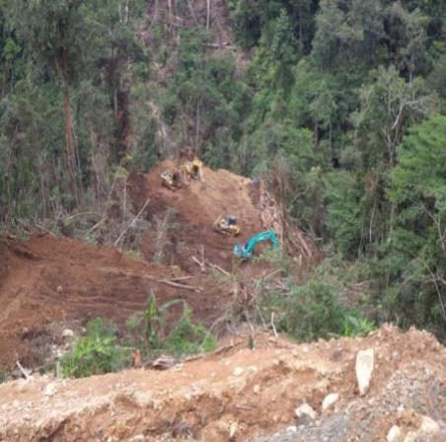
Building infrastructure for exploration program needs experienced and specialized capabilities

Slide 31
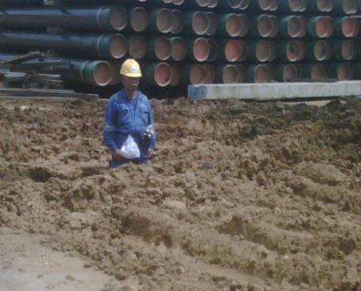
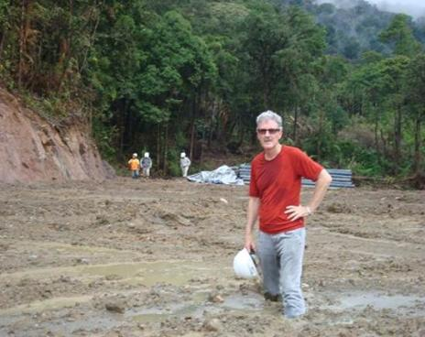
Near Geothermal system, there are possibilities of soft soil condition (Geothermally altered clay)
Various technology to improve soil condition needs to be implemented such as the use of Geogrid, Geotextile, Lime stabilizer, Clean set cements

Slide 32
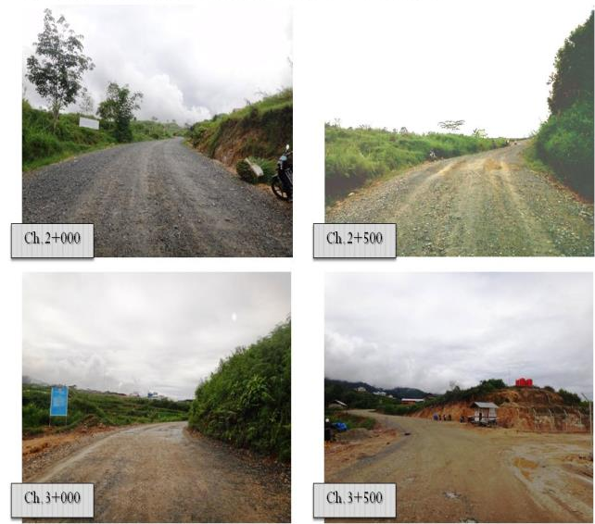
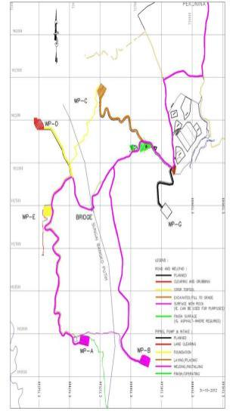
After construction access road are completed

Slide 33
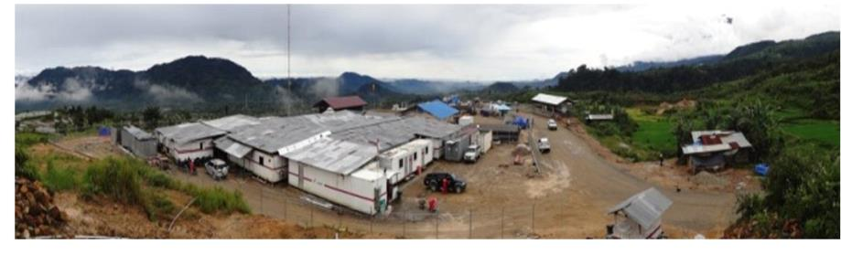
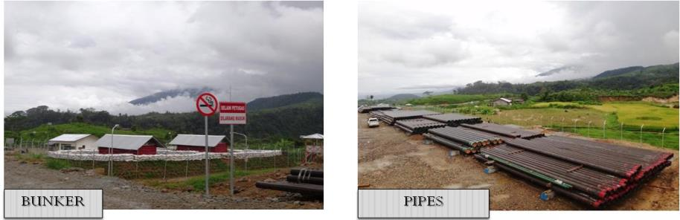
Muara Laboh Project
Drilling camp, Explosive bunker, Warehouse and laydown for Pipe casing storage

Slide 34
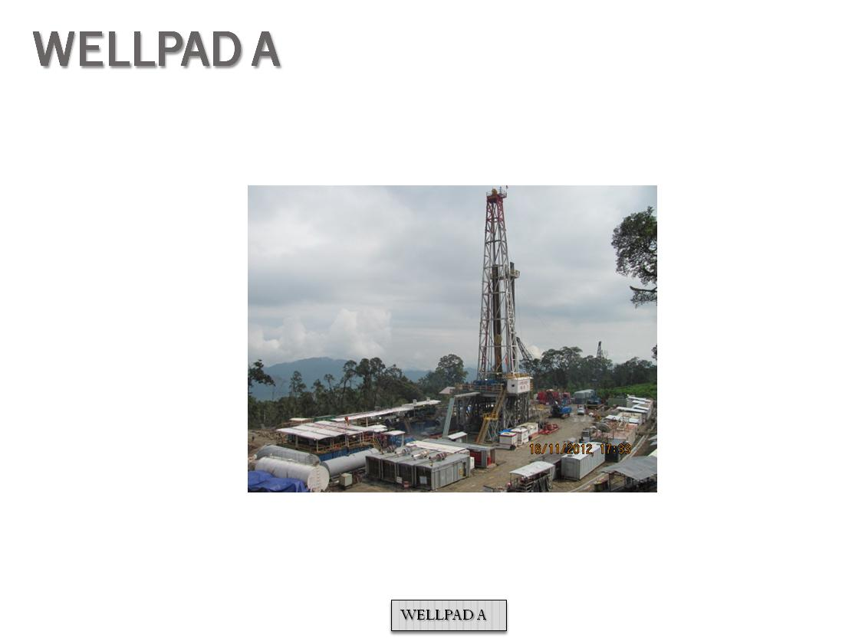
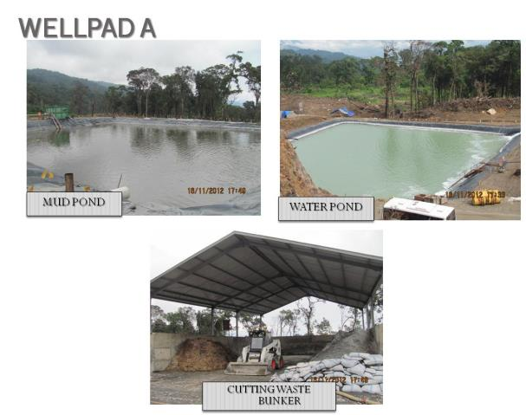
Drilling activities started

Slide 35
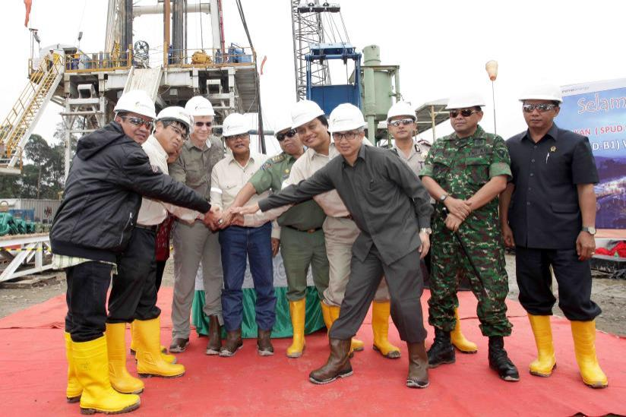
Spud date ceremony invite government officials

Slide 36
Presentation Agenda
PT Supreme Energy companies
Government guarantee breakthrough
Electricity Price breakthrough
Restricted forest entry breakthrough
Financing for exploration breakthrough
Civil infrastructure breakthrough
Exploration breakthrough
Summary

Slide 37

Geothermal systems were found in Muara Laboh

Slide 38
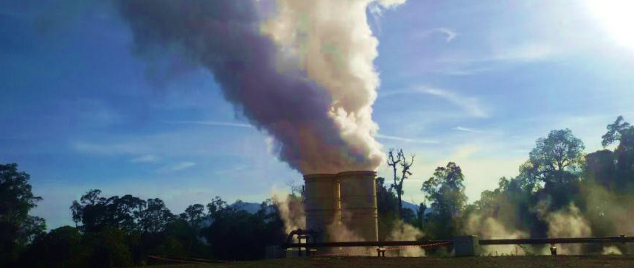
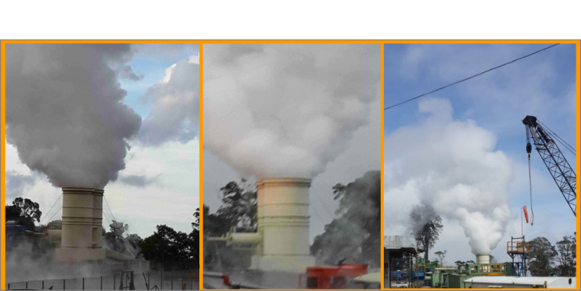
Geothermal systems were found
in Rantau Dedap
RD-B1 Flowing Dec 4th, 2014
BOC Meeting,
Jakarta
December 2014

Slide 39

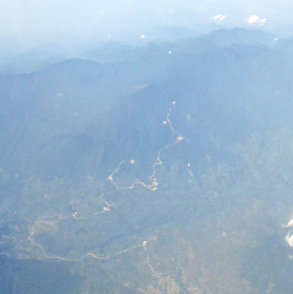

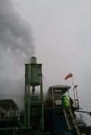

Significant reserve found
only with 4 wells drilling
Bkt Besar Crater
Pad C
Pad I
RD-C1
Pad B
Pad E
RD-B1
RD-I1
RD-B2

Slide 40
Summary
Government guarantee breakthrough
Electricity Price breakthrough
Restricted forest entry breakthrough
Financing for exploration breakthrough
Civil infrastructure breakthrough
Exploration breakthrough

